Slide 1
Service Mesh
Kubernetes on AWS
version 0.8.1

Slide 2
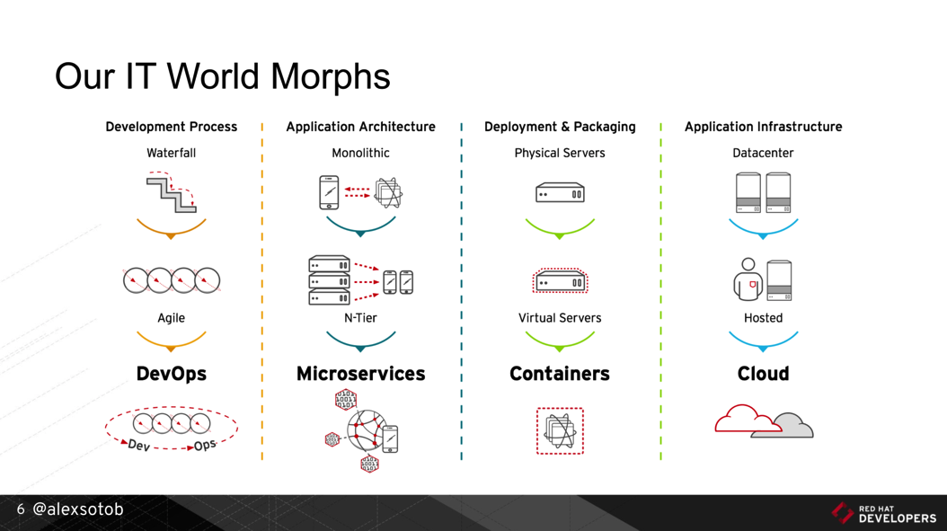
1. Digital Transformation: IT World is changing
https://www.slideshare.net/asotobu/sail-in-the-cloud

Slide 3
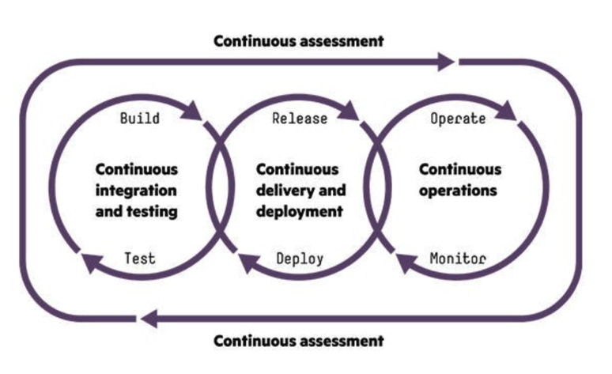
1. Digital Transformation: CI/CD, DevOps, Jenkins,..
https://www.slideshare.net/asotobu/sail-in-the-cloud

Slide 4
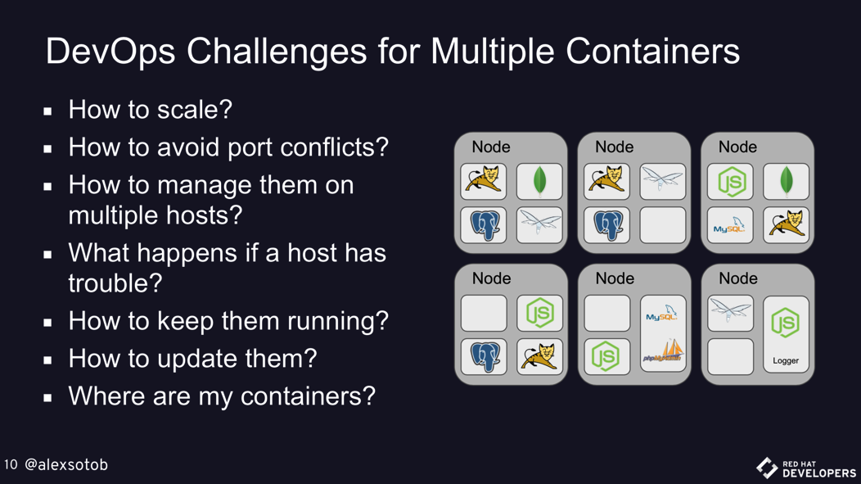
1. Digital Transformation: New challenges
https://www.slideshare.net/asotobu/sail-in-the-cloud

Slide 5
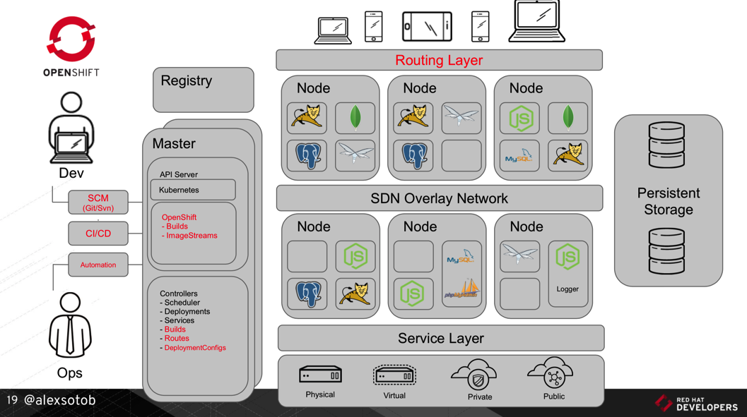
1. Digital Transformation: A new Platform
https://www.slideshare.net/asotobu/sail-in-the-cloud

Slide 6
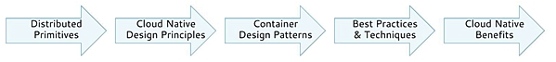
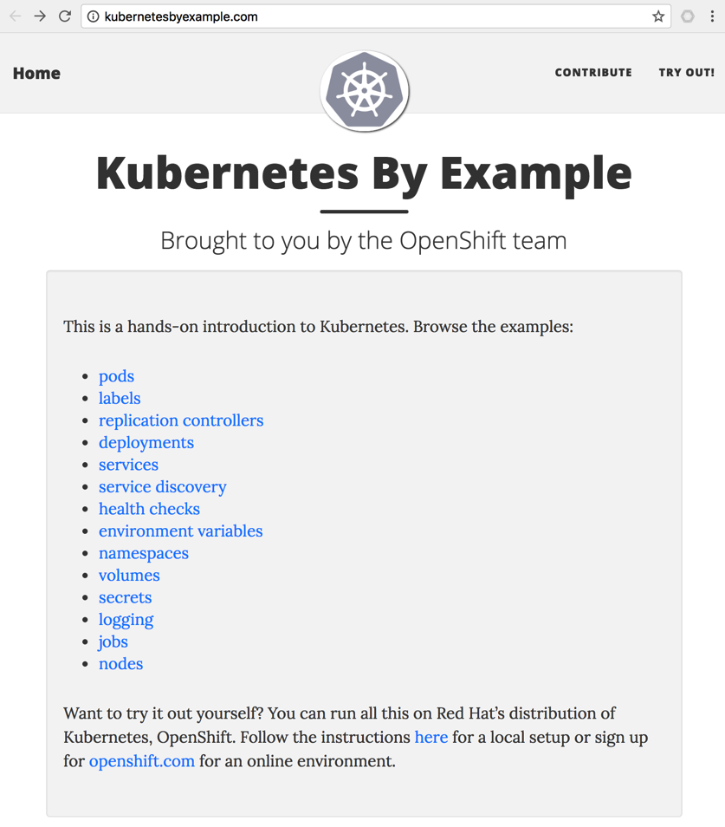
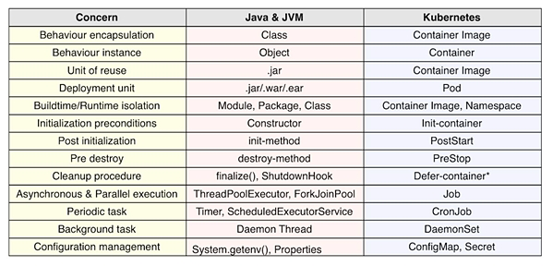
2. Kubernetes effect on the SDLC: Primitives (1/2)
1
https://www.infoq.com/articles/kubernetes-effect

Slide 7
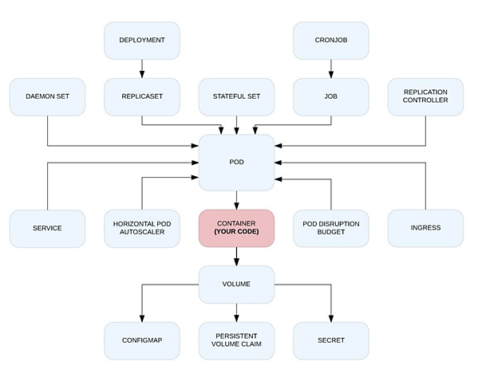
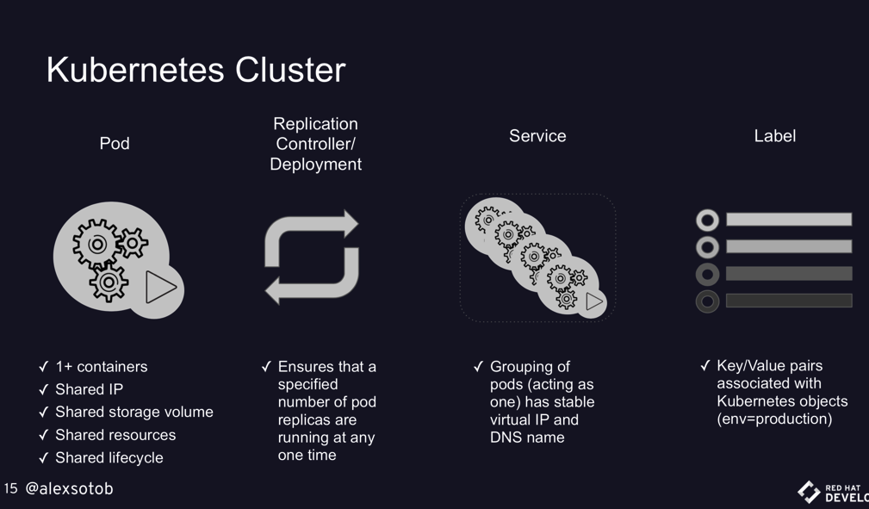
2. Kubernetes effect on the SDLC: Primitives (2/2)
1
https://www.infoq.com/articles/kubernetes-effect
https://www.slideshare.net/asotobu/sail-in-the-cloud

Slide 8
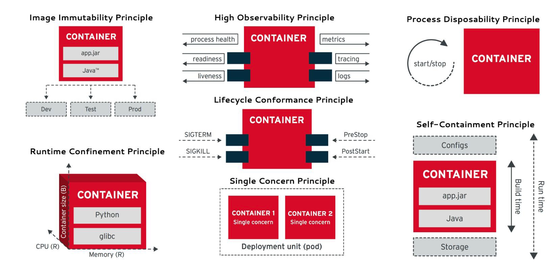
2. Kubernetes effect on the SDLC: Principles
2
https://www.infoq.com/articles/kubernetes-effect

Slide 9
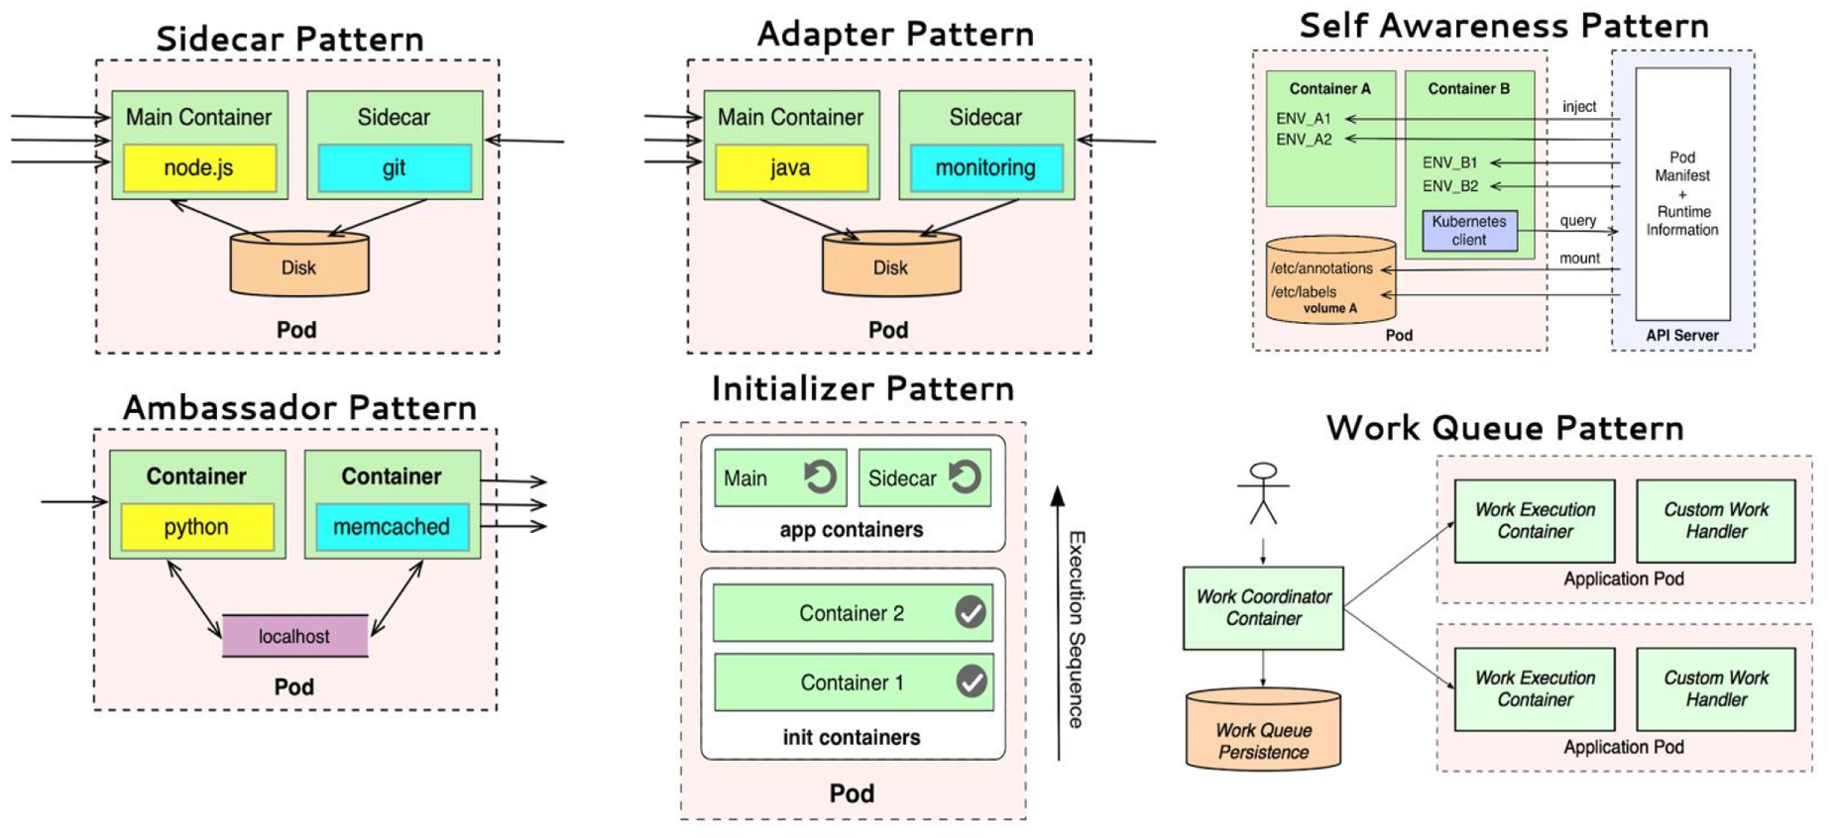
2. Kubernetes effect on the SDLC: Patterns
3
https://www.infoq.com/articles/kubernetes-effect

Slide 10
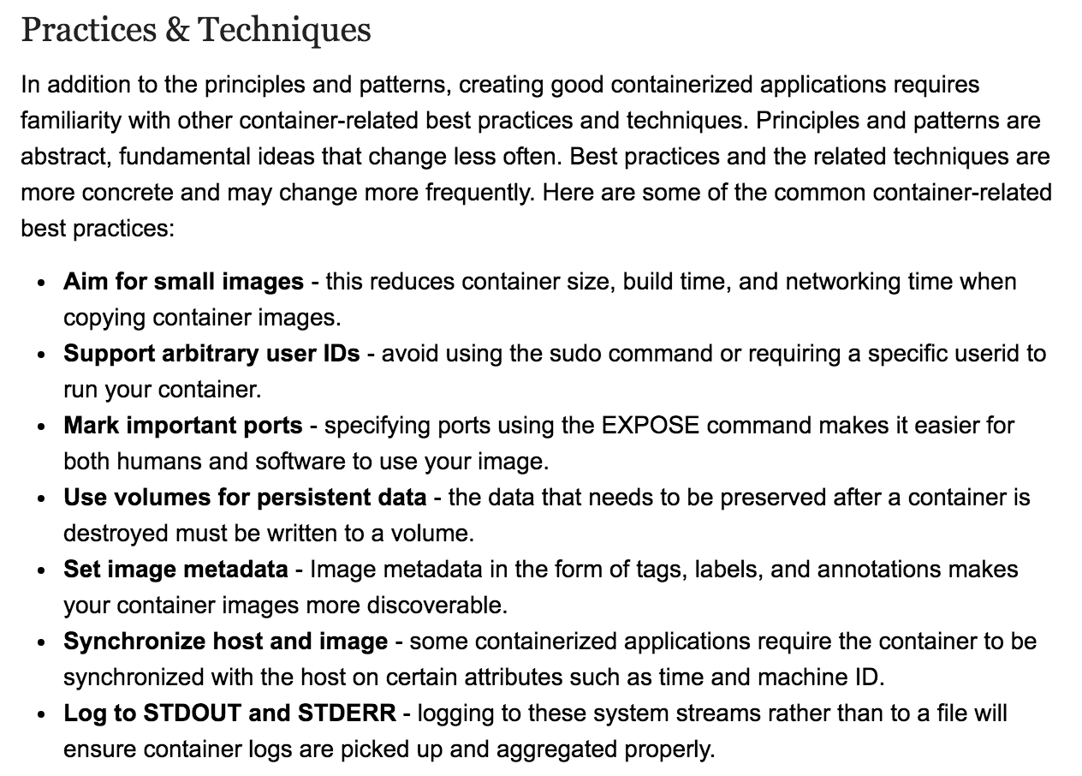
2. Kubernetes effect on the SDLC: Best Practices
4
https://www.infoq.com/articles/kubernetes-effect

Slide 11
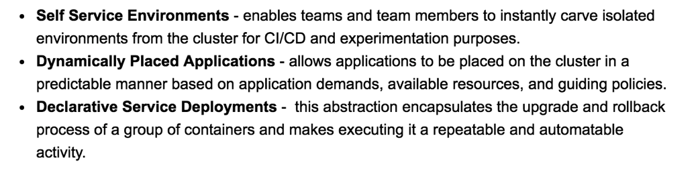
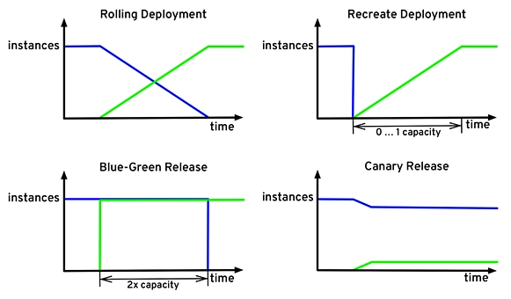
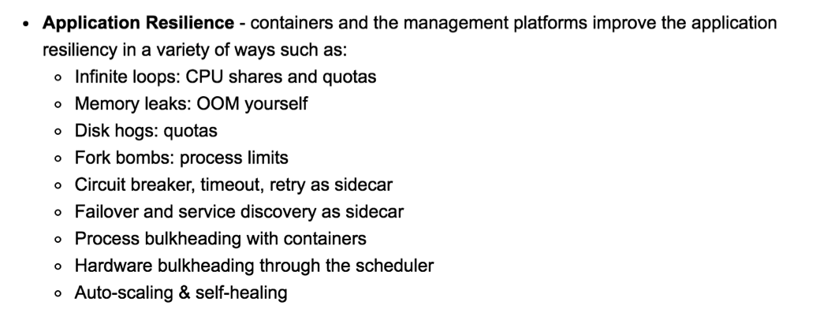
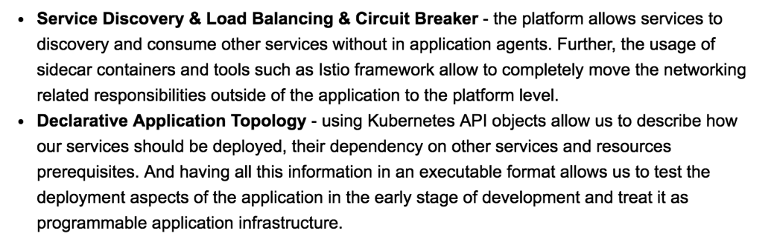
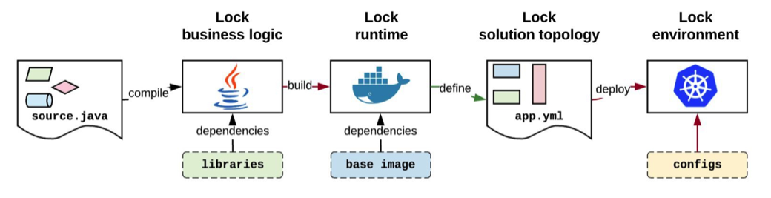
2. Kubernetes effect on the SDLC: Benefits
5
https://www.infoq.com/articles/kubernetes-effect

Slide 12

3. Lab 00: Building K8s - choose yours (1/2)
Google Kubernetes Engine
kubectl
Amazon EC2
istioctl
Kubernetes Cluster
Azure Container Service (AKS)
oc
On-premise
istioctl
OpenShift v3
KVM
RedHat
VMWare
OpenShift
az
Minikube
istioctl
Minishift
Amazon Fargate
Amazon EKS
Amazon ECS

Slide 13
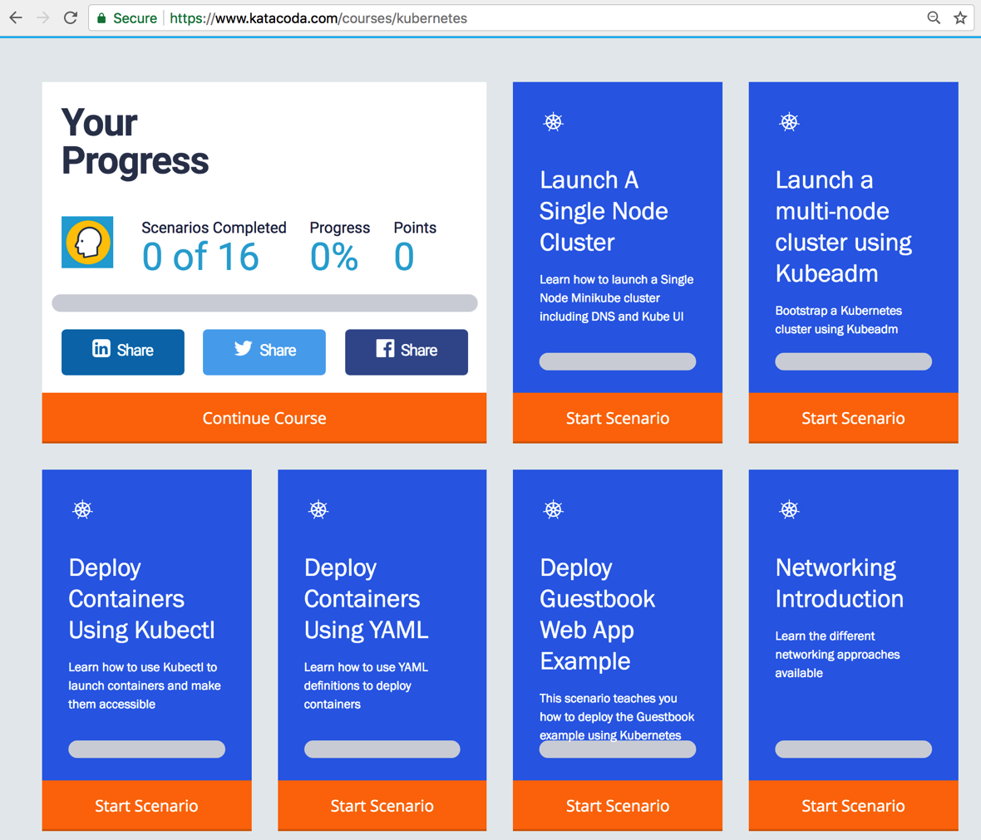
3. Lab 00: Building K8s - acquire practice (2/2)
1
http://kubernetesbyexample.com
https://www.katacoda.com/courses/kubernetes

Slide 14

3. Lab 01: Delivering Services on Kubernetes 1/3
Amazon EC2
Kubernetes
Node₁
Edge Proxy
(Load Balancer)
Port₁
LoadBalancer
http://PublicIP₁:Port_{pub1}
nodePort₁
Pod₁
Docker₁
Docker Registry
Port₂: 5002
NodePort
nodePort₂
(hello-svc-np)
5000
(hello-v1)
Node₂
Port₃
ClusterIP
Pod₂
nodePort₃: --
Docker₂
5000
(hello-v2)
curl <clusterIP>:<nodePort>/hello
Services
Deployment
## scheduling step by step
$ kubectl apply –f labs/kube/01-delivering-on-k8s/hello-ns-sa.yaml
$ kubectl apply –f labs/kube/01-delivering-on-k8s/hello-deployment.yaml
$ kubectl apply –f labs/kube/01-delivering-on-k8s/hello-services.yaml
## scheduling all together
$ kubectl apply –f labs/kube/01-delivering-on-k8s/hello-all.yaml

Slide 15
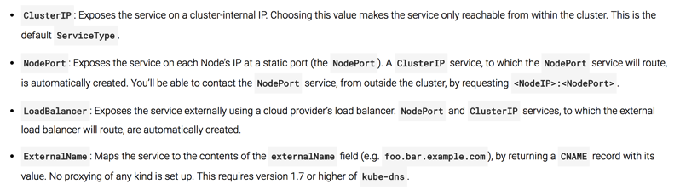
4. Lab 02: Exposing Services - Ingress 1/4
Amazon EC2
Edge Proxy
(Load Balancer)
Kubernetes
Node₁
Port₁: 81, CIP₁
Services
LoadBalancer
http://PublicIP₁:Port_{pub1}
Pod₁
Ingress Controller
nodePort₁
Docker₁
http://PublicIP₂:Port_{pub2}
Port₂: 82, CIP₂
NodePort
nodePort₂
8080
Route <http>://<IP>:<Port>/<Path>
To CIP₂:Port₂
Port₃: 83, CIP₃
ClusterIP
nodePort₃: --
Kubernetes
Node₂
Pod₂
Docker₂
8080
External Network
spec.loadBalancerIp:spec.pops[*].port
Internal Network (Backend)
<NodeIP>:spec.ports[*].nodePort
spec.clusterIp:spec.ports[*].port

Slide 16
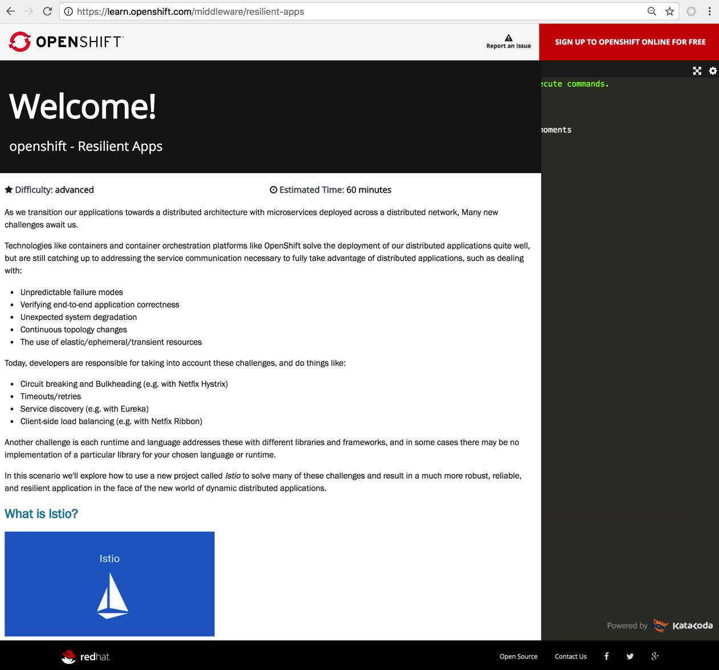
3. Lab 03: Weaving Service Mesh - Istio
https://learn.openshift.com/middleware/resilient-apps

Slide 17


3. Lab 04: Deploying on Service Mesh
Amazon EC2
Edge Proxy
(Load Balancer)
Kubernetes
Node₁
Services
ClusterIP
Pod₁
Service Mesh Control Plane
Istio Ingress
Docker₁
ClusterIP
Sidecar₁
Istio Auth
ClusterIP
Istio Pilot
Istio Mixer
Kubernetes
Node₂
Pod₂
Istio CA
Docker₂

Slide 18
3. Lab 05: Chaining Microservices/APIs
Amazon EC2
Edge Proxy
(Load Balancer)
Kubernetes
Node₁
Service Mesh Control Plane
Services
Pod₁
Pod₂
ClusterIP₁
Docker₁
Docker₂
Istio Ingress
(5000)
(5001)
(6000)
(test1-ambassador-svc)
(gis-test-sidecar)
(gis-test-api)
Istio Auth
ClusterIP₂
Istio Pilot
(test1-svc)
(5050)
Istio Mixer
Istio CA

